Slide 1
Prompt Your Future!
GenAI Toolkit
International Women’s Day
Shira Weinberg Harel
This deck includes:
Instructor preparation
Lesson content

Slide 2
Prompt
Your
Future!
GenAI Toolkit
Amdocs project for IWD
Notes:
Lesson Structure

Slide 3
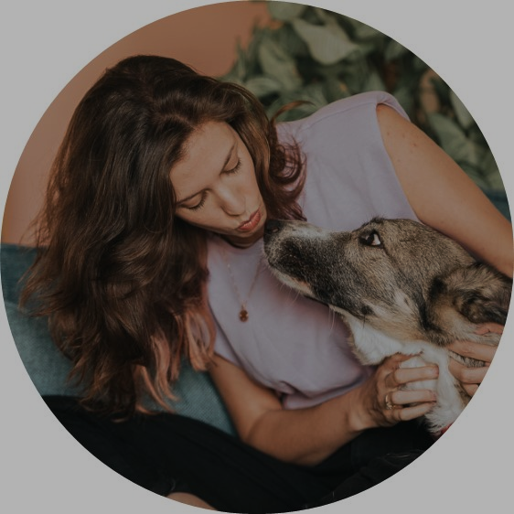
Hello!
PLACE
INSTRUCTORS
PHOTO
HERE
Είμαι ο/η {name}
Notes:
Instructions: Present yourself, a few words about what you do at work and what we’re going to do in this lesson

Slide 4
Ας ξεκινήσουμε με ένα παιχνίδι!
Notes:
Instructions: Today we’re going to learn about AI, but let’s start with a game!

Slide 5
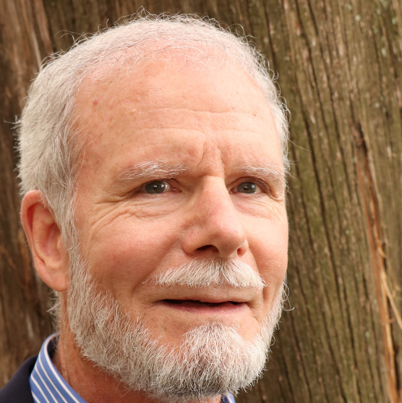
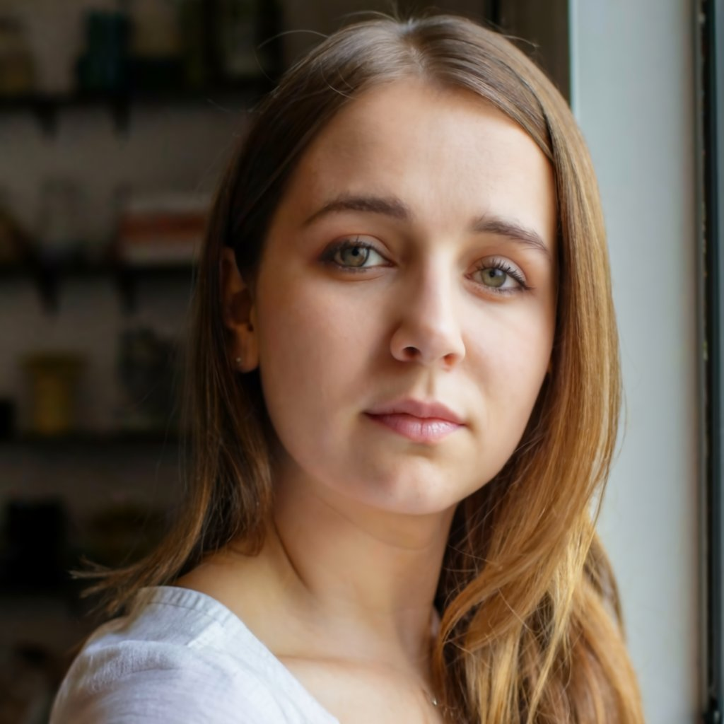
Ποιά εικόνα είναι πραγματική;
Πραγματικός
Notes:
Instructions: Which of these people is real? Who thinks the right one (girl) is real? (ask them to raise their hand), Who thinks the left one is real?

Slide 6
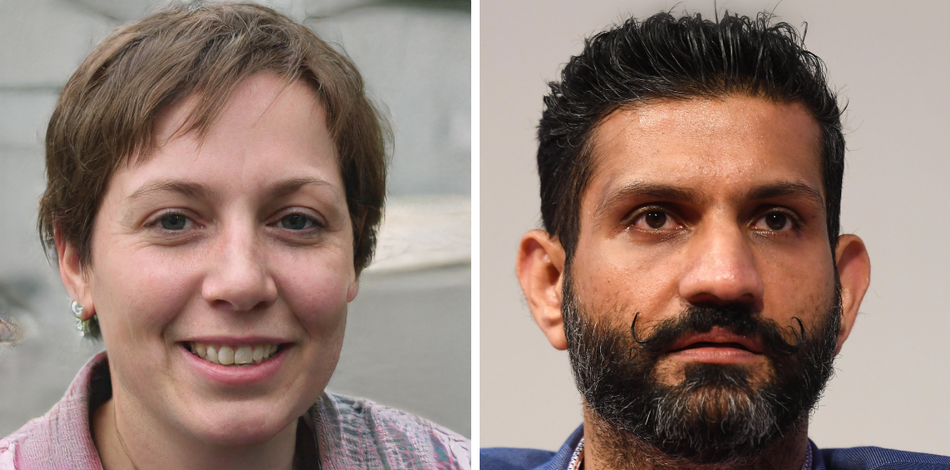
Ποιά εικόνα είναι πραγματική;
Πραγματικός
Notes:
Instructions Who thinks the right one is real? (ask them to raise their hand), Who thinks the left one is real?

Slide 7
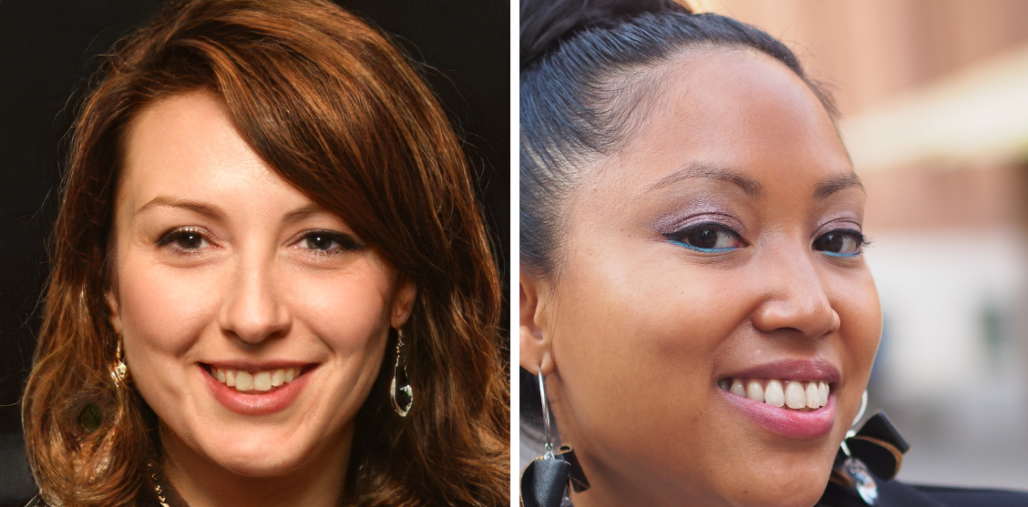
Ποιά εικόνα είναι πραγματική;
Πραγματικός
https://www.whichfaceisreal.com/
Notes:
Instructions: Who thinks the right one is real? (ask them to raise their hand), Who thinks the left one is real?
So you can see it’s not that easy, and AI today can create things that look totally real.
Critical thinking: This also mean we should be very careful these days, and remember that if we see or read something – it doesn’t mean that it’s real.

Slide 8
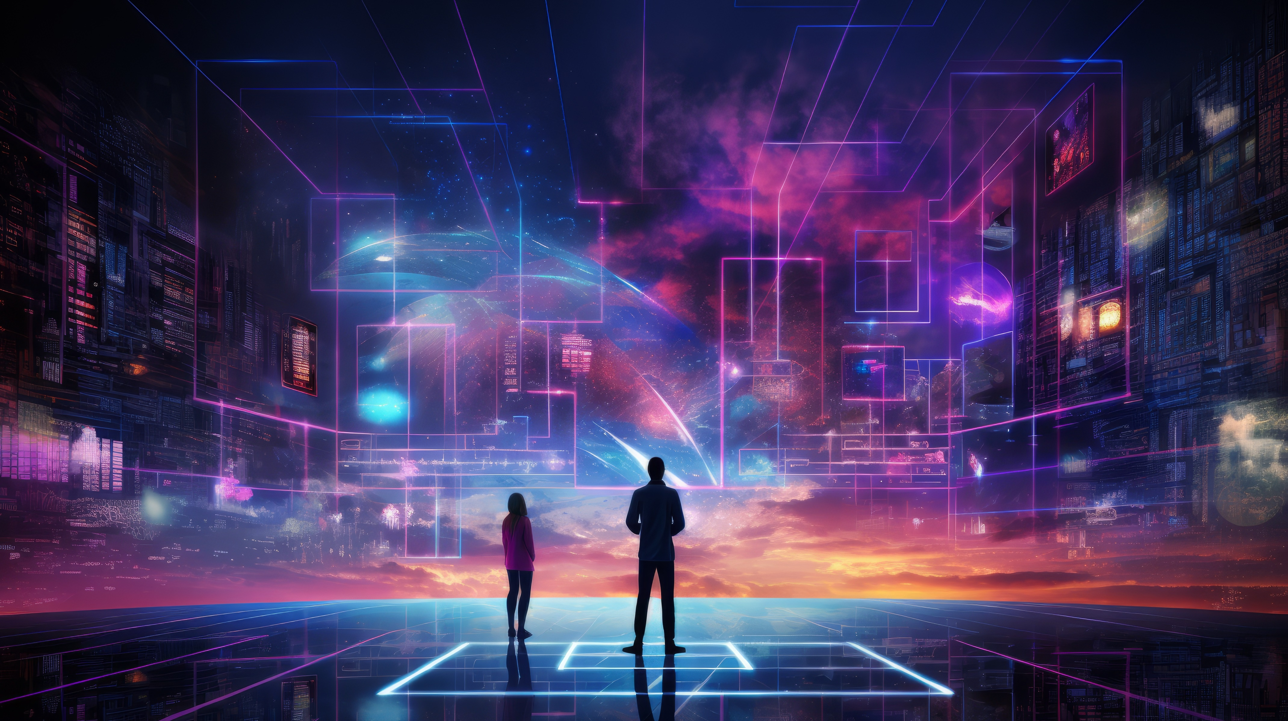
Τι είναι η Τεχνητή Νοημοσύνη;
Notes:
Instructions: Ask the class what is AI, let them try to answer before sharing the definition. Encourage them to provide more info/versions.

Slide 9
Τι είναι η Τεχνητή Νοημοσύνη;
Η Τεχνητή Νοημοσύνη, ή AI (Artificial Intelligence), είναι σαν τον εγκέφαλο ενός υπολογιστή που του επιτρέπει να μαθαίνει, να παίρνει αποφάσεις και να εκτελεί εργασίες από μόνος του.
Όπως εμείς μαθαίνουμε από τις εμπειρίες μας και γινόμαστε καλύτεροι στο να κάνουμε πράγματα με τον καιρό.
Notes:
Instructions: Provide positive feedback about their answers and more to the explanation about what is AI.

Slide 10
Πού συναντάμε
ΑΙ
σήμερα;
Notes:
Instructions: Ask the class before sharing the examples, encourage them to give several answers

Slide 11
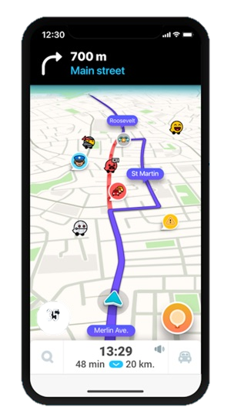
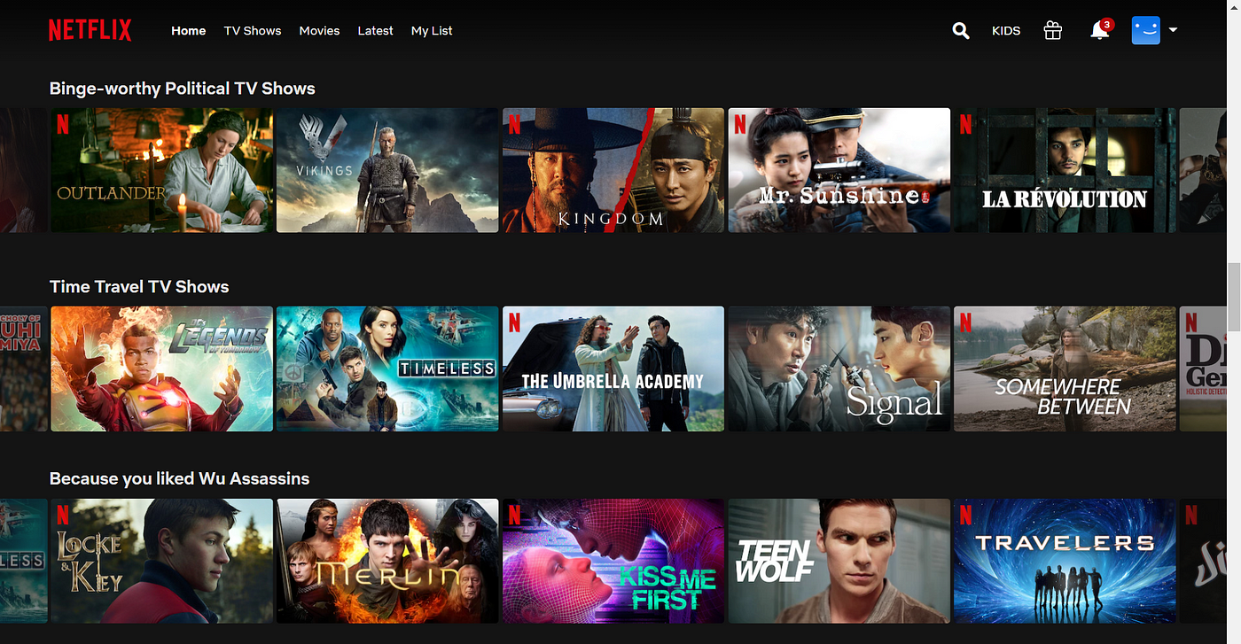

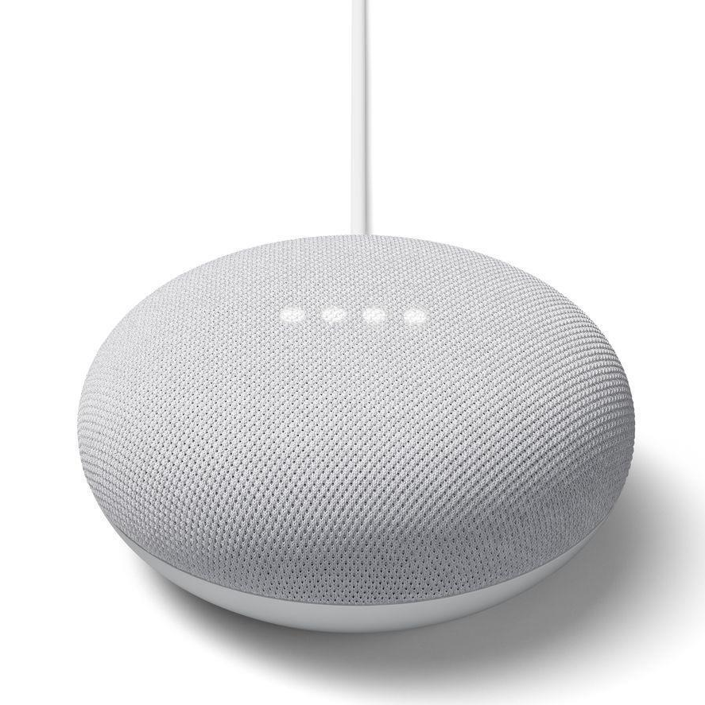
Πού συναντάμε ΑΙ σήμερα;
Notes:
Instructions: provide examples of where we see AI in tools they already use today.
Some examples to use:
Navigation apps learn the road, the information from other drivers…
Netflix recommendations are based on AI that learns from how people use Netflix
Siri and Alexa can understand natural language when speaking with them and respond in natural language

Slide 12
Η AI μπορεί να δημιουργήσει περιεχόμενο για εμάς
Τεχνητή Νοημοσύνη που μπορεί να δημιουργήσει κείμενο, εικόνες, τραγούδια, βίντεο και περισσότερα
Το αποκαλούμε “Γεννητική Τεχνητή Νοημοσύνη”
(Generative AI)
Notes:
Instructions: Explain that Gen AI is a new category that is focused on creating content

Slide 13
Notes:
Instructions: This Coca Cola commercial was created using AI. AI is being used in so many aspect
https://www.youtube.com/watch?v=nSmNy9iLhZ4&ab_channel=FanaticalFuturistby311Institute

Slide 14
Τώρα θα εφεύρουμε έναν νέο υπερήρωα
Ο υπερήρωάς μου θα είναι ένα 10χρονο κορίτσι
Ποια δύναμη θα έπρεπε να έχει;
Θα ήθελα να έχει φτερά, ποιο χρώμα;
Επιπλέον ιδέες;
Notes:
Instructions: Explain that we’re going to invent a superhero, we will start from our ideas and then AI will help us make it real.
Provide your own example (you can update the slide), choose a female character to provide inspiration to the girls in the class.
Together with the class, give her 2-3 basic characteristics (at least some should be related to how she looks like, in order to generate her image later).
Advanced classes: Discuss more characteristics: texture of the wings? Additional features like accessories? Where does she live?

Slide 15
Τώρα θα εφεύρουμε έναν νέο υπερήρωα
Αφιερώστε ένα λεπτό για να φανταστείτε τον υπερήρωα σας
Κάτι ιδιαίτερο σχετικά με τη στολή τους; (ένα στέμμα, φτερά, μια πράσινη ζώνη)
Ποια θα είναι η υπερδύναμή τους;
Notes:
Instructions: Now it’s the classes turn – take a few minutes to invent your own superhero.

Slide 16
Πώς μπορεί η τεχνητή νοημοσύνη να μας βοηθήσει εδώ;
Notes:
Instructions: Explain how AI can help us – show Copilot and explain it’s a Generative AI tool that creates text for us.
Show how you ask it to help build your character (you can ask: what color of clothes should she wear? How should I call her?)
Critical thinking: You can decide whether to take AIs advice or not, you can provide your feedback and ask for changes or more ideas.

Slide 17
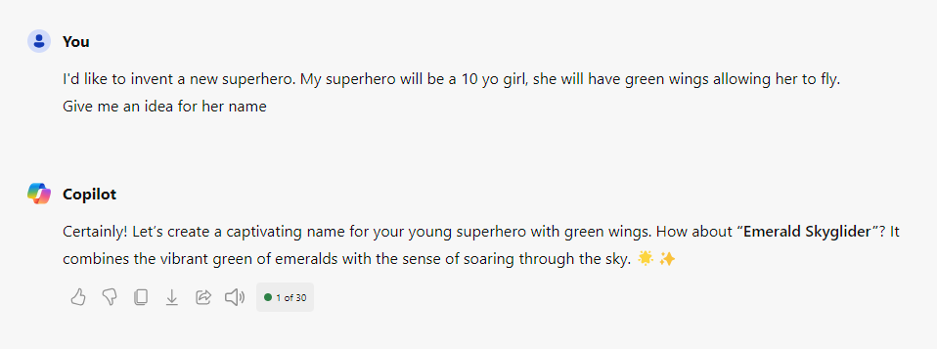
How can AI help us here?
This is a placeholder, the instructor will show a live demo of this scenario
Notes:
Instructions: Explain how AI can help us – show Copilot and explain it’s a Generative AI tool that creates text for us.
Show how you ask it to help build your character (you can ask: what color of clothes should she wear? How should I call her?)
Explain that AI is also learning from their usage. They are making an impact: When you use GenAI, you're not just a user; you're actually helping to improve and shape it for the better.
Critical thinking: You can decide whether to take AIs advice or not, you can provide your feedback and ask for changes or more ideas.

Slide 18
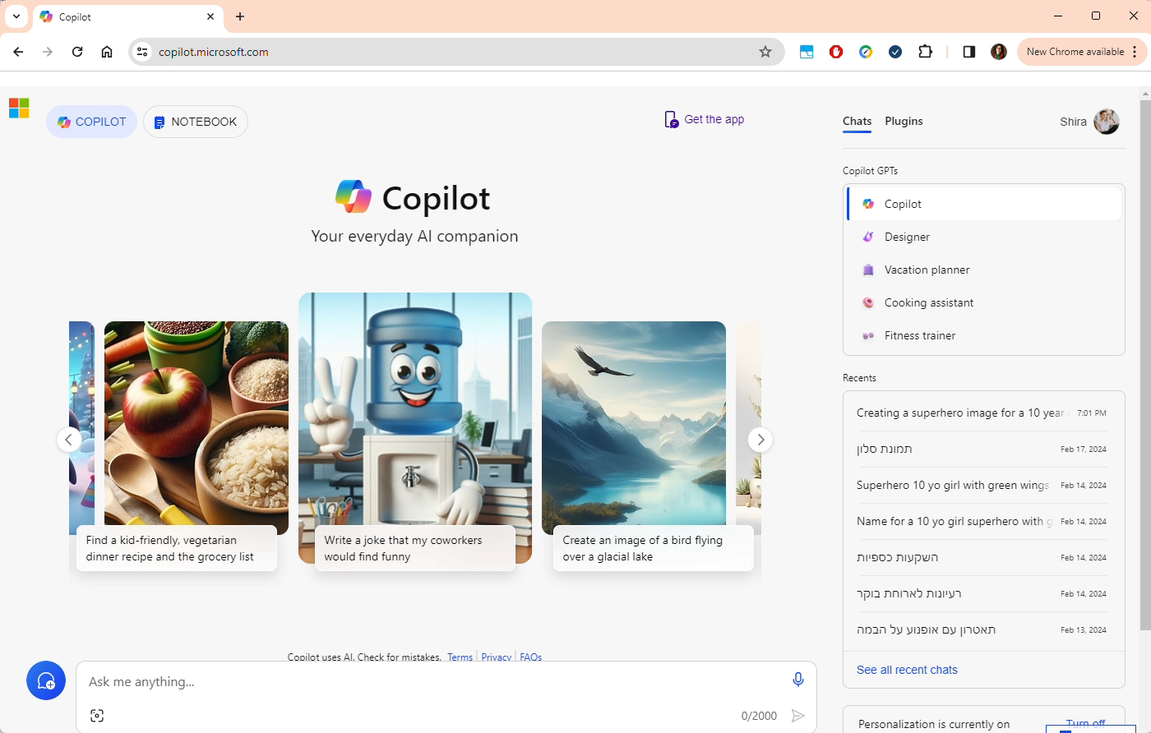

Slide 19
Η σειρά σας
Χρησιμοποιήστε το Copilot, συνδεθείτε και ρωτήστε "βοήθησέ με να περιγράψω τον υπερήρωά μου..."
Να πάρετε ιδέες για τη στολή της;
Να της δώσετε ένα όνομα;
https://copilot.microsoft.com/
Notes:
Instructions: Show them how to login to Copilot and use it to enrich their character
For any unexpected issues you can use ChatGPT as an alternative.

Slide 20
Πώς θα ήταν η εμφάνισή της;
Notes:
Instructions: Explain that now we’re going the create her pictures! We’re going to ask copilot to create images for us
Note: after the class, share the images you created with the kids (on your laptop) with the Amdocs team

Slide 21
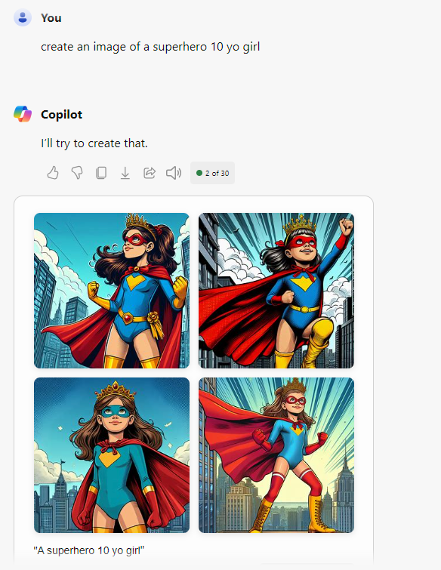
Πώς θα ήταν η εμφάνισή της;
This is a placeholder, the instructor will show
a live demo of
this scenario
Notes:
Instructions: Explain that now we’re going the create her pictures! We’re going to ask copilot to create images for us.
Explain that when providing general instructions we get a pretty general superhero image. (e.g. “Create an image of a superhero 10 yo girl”)

Slide 22
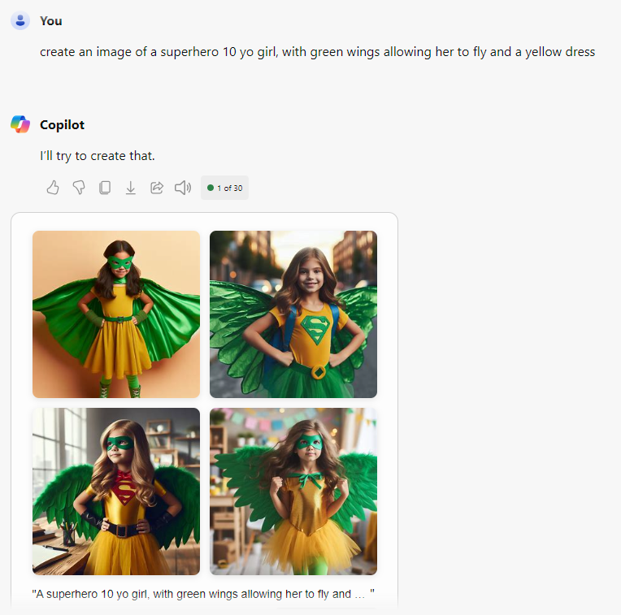
Πώς θα ήταν η εμφάνισή της;
This is a placeholder, the instructor will show
a live demo of
this scenario
Notes:
Instructions: Show how using more concrete directions gives us the results we want (clothes, wings, item colors, etc.)
For advanced classes, older kids etc. – try various prompts to change the style and add more content, for example:
“Create a cartoon of a 10 yo superhero girl with green wings”
“Create a Pixar style image of a 10 yo superhero girl with green wings. She is in class studying with her friends”

Slide 23
Η σειρά σας
Χρησιμοποιήστε τον copilot για να δημιουργήσετε την εικόνα
Ρωτήστε το Copilot: "Δημιούργησε μια εικόνα ενός/μιας..."
Προσπαθήστε να την περιγράψετε με πρόσθετους τρόπους και δείτε ποια αποτελέσματα σας αρέσουν περισσότερο
Notes:
Instructions: Now it’s the classes turn – take a few minutes to create the images of the suprhero

Slide 24
Σύνοψη

Slide 25
Σύνοψη
Τι μάθαμε;
Notes:
Instructions: Ask the kids - Can I trust every answer I get from AI? Can I tell AI everything I want?
Remind them about the game we started with – it’s difficult to know what’s real and what’s not real, and as technology becomes more advance it will be even more difficult, so we need to be cautious and remember that not everything we see or read is real.
Explain that AI will always answer, even if it doesn’t really know the correct answer, and we should be careful about how we use the result we get from AI. IT’s great to get ideas from it and generate content, but if we’re looking for facts we need to be more cautious
Remind them that AI keeps learning, and it’s also learning from our usage and from what you ask

Slide 26
Σύνοψη
Τι μάθαμε;
Πώς μπορεί να σας βοηθήσει;
Notes:
Instructions: Ask the kids - Can I trust every answer I get from AI? Can I tell AI everything I want?
Remind them about the game we started with – it’s difficult to know what’s real and what’s not real, and as technology becomes more advance it will be even more difficult, so we need to be cautious and remember that not everything we see or read is real.
Explain that AI will always answer, even if it doesn’t really know the correct answer, and we should be careful about how we use the result we get from AI. IT’s great to get ideas from it and generate content, but if we’re looking for facts we need to be more cautious
Remind them that AI keeps learning, and it’s also learning from our usage and from what you ask

Slide 27
Σύνοψη
Τι μάθαμε;
Πώς μπορεί να σας βοηθήσει;
Πώς μπορείτε να το βοηθήσετε;
Notes:
Instructions: Ask the kids - Can I trust every answer I get from AI? Can I tell AI everything I want?
Remind them about the game we started with – it’s difficult to know what’s real and what’s not real, and as technology becomes more advance it will be even more difficult, so we need to be cautious and remember that not everything we see or read is real.
Explain that AI will always answer, even if it doesn’t really know the correct answer, and we should be careful about how we use the result we get from AI. IT’s great to get ideas from it and generate content, but if we’re looking for facts we need to be more cautious
Remind them that AI keeps learning, and it’s also learning from our usage and from what you ask

Slide 28
Σύνοψη
Τι μάθαμε;
Πώς μπορεί να σας βοηθήσει;
Πώς μπορείτε να το βοηθήσετε;
Μπορούμε
να εμπιστευτούμε
την ΤΕ;
Notes:
Instructions: Ask the kids - Can I trust every answer I get from AI? Can I tell AI everything I want?
Remind them about the game we started with – it’s difficult to know what’s real and what’s not real, and as technology becomes more advance it will be even more difficult, so we need to be cautious and remember that not everything we see or read is real.
Explain that AI will always answer, even if it doesn’t really know the correct answer, and we should be careful about how we use the result we get from AI. IT’s great to get ideas from it and generate content, but if we’re looking for facts we need to be more cautious
Remind them that AI keeps learning, and it’s also learning from our usage and from what you ask

Slide 29




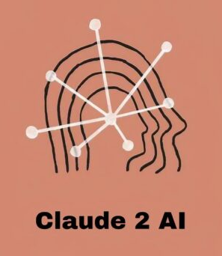


Επιπλέον εργαλεία για δοκιμή στο σπίτι
Text Generation
Image Generation
Notes:
Instructions: for advanced classes, you can direct them to additional tools they can try at home by themselves
Text generation:
https://gemini.google.com/app
https://chat.openai.com/
https://claude.ai/
Image generation:
https://ideogram.ai/
https://clipdrop.co/
https://firefly.adobe.com/

Slide 30
Ευχαριστώ

