Slide 1
Prompt Your Future!
GenAI Toolkit
International Women’s Day
Shira Weinberg Harel
This deck includes:
Instructor preparation
Lesson content

Slide 2
Prompt
Your
Future!
GenAI Toolkit
Amdocs project for IWD
Notes:
Lesson Structure

Slide 3
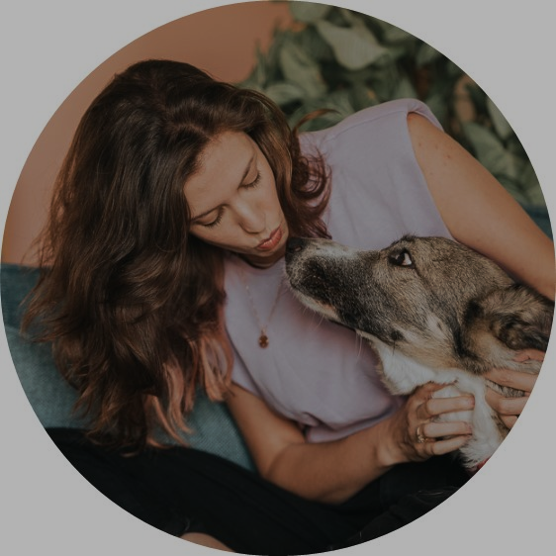
¡Hola!
PLACE
INSTRUCTORS
PHOTO
HERE
Soy {nombre}
Notes:
Instructions: Present yourself, a few words about what you do at work and what we’re going to do in this lesson

Slide 4
¡Empecemos con un juego!
Notes:
Instructions: Today we’re going to learn about AI, but let’s start with a game!

Slide 5
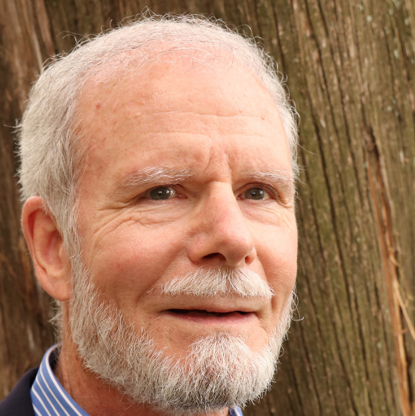
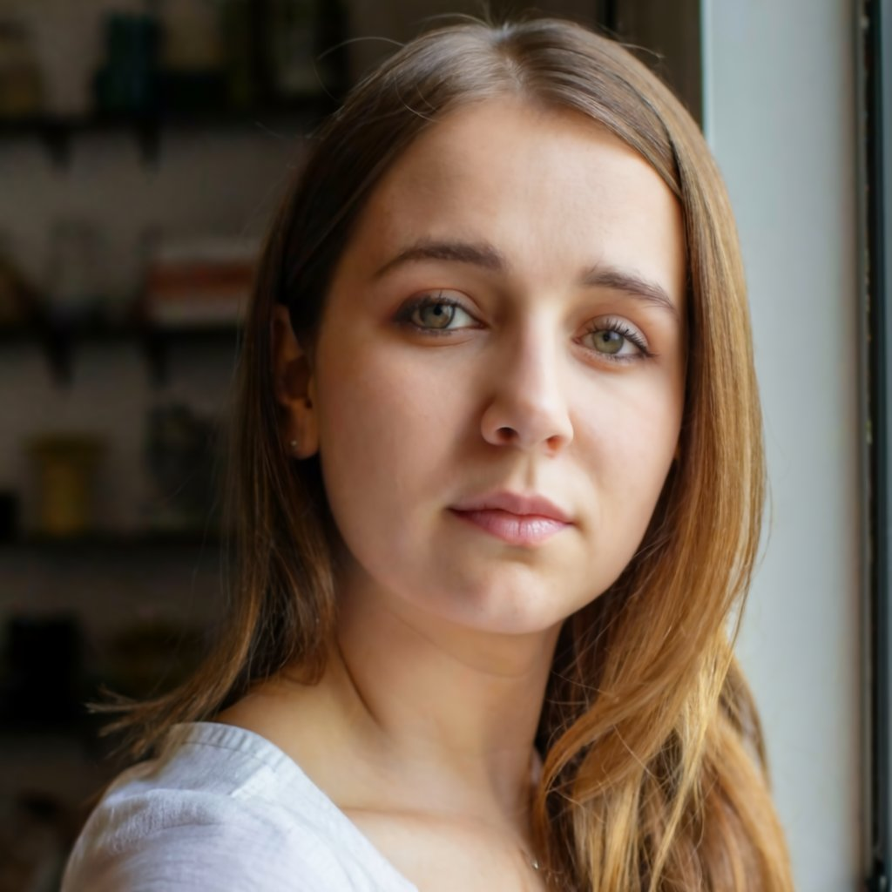
¿Cuál de ellos es real?
Real
Notes:
Instructions: Which of these people is real? Who thinks the right one (girl) is real? (ask them to raise their hand), Who thinks the left one is real?

Slide 6
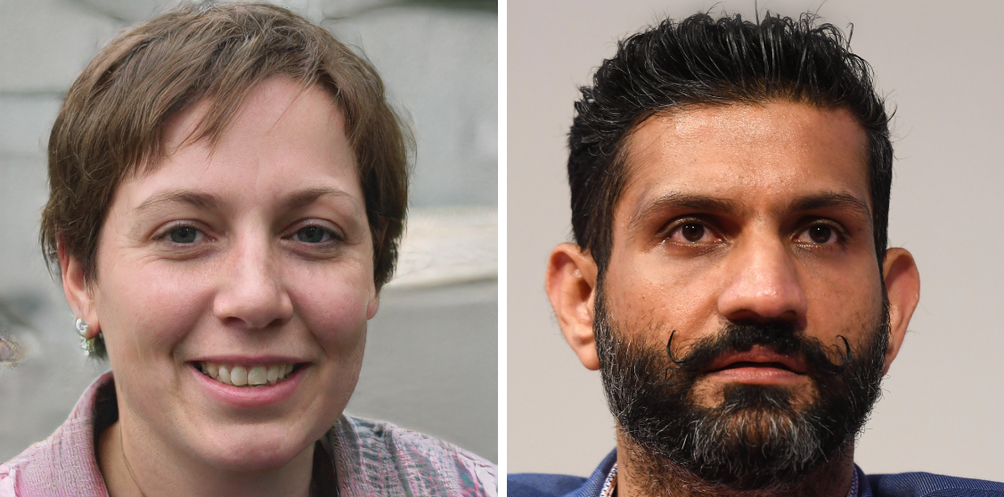
¿Cuál de ellos es real?
Real
Notes:
Instructions Who thinks the right one is real? (ask them to raise their hand), Who thinks the left one is real?

Slide 7
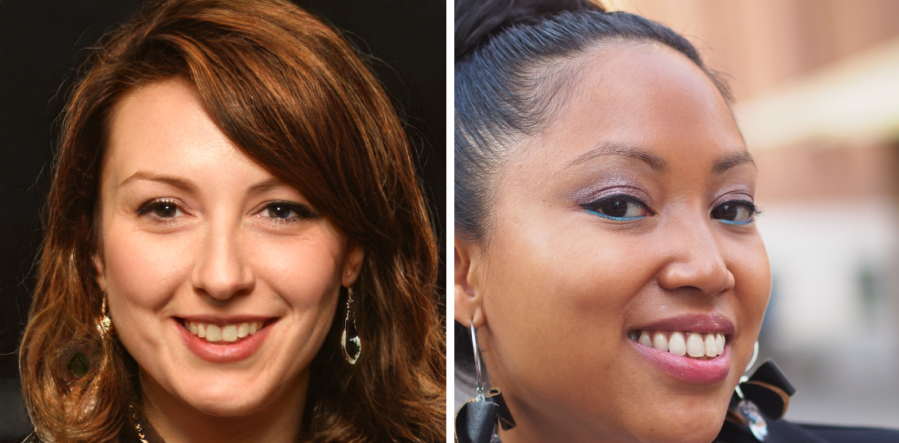
¿Cuál de ellos es real?
Real
https://www.whichfaceisreal.com/
Notes:
Instructions: Who thinks the right one is real? (ask them to raise their hand), Who thinks the left one is real?
So you can see it’s not that easy, and AI today can create things that look totally real.
Critical thinking: This also mean we should be very careful these days, and remember that if we see or read something – it doesn’t mean that it’s real.

Slide 8
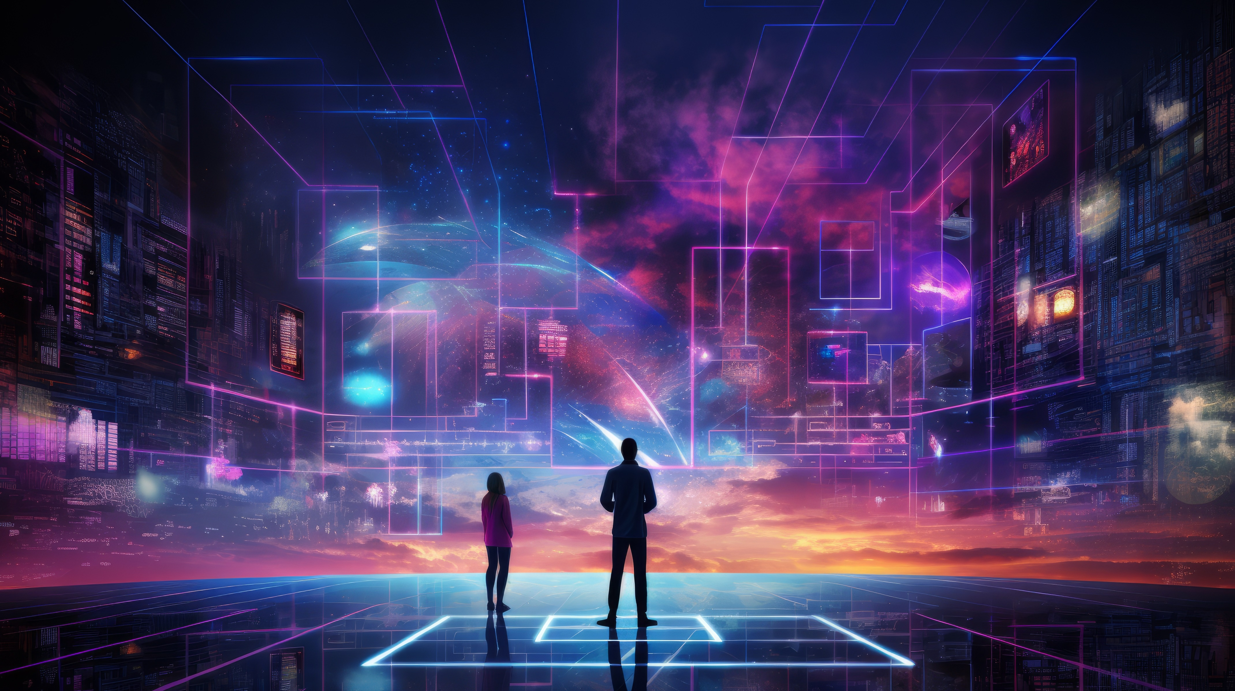
¿Qué es la IA?
Notes:
Instructions: Ask the class what is AI, let them try to answer before sharing the definition. Encourage them to provide more info/versions.

Slide 9
¿Qué es la IA?
La inteligencia artificial, o IA, es como el cerebro de un ordenador que le permite aprender, tomar decisiones y realizar tareas por sí mismo.
Como nosotros aprendemos de nuestras experiencias y mejoramos en hacer cosas con el tiempo.
Notes:
Instructions: Provide positive feedback about their answers and more to the explanation about what is AI.

Slide 10
¿Dónde encuentras la IA hoy en día?
Notes:
Instructions: Ask the class before sharing the examples, encourage them to give several answers

Slide 11
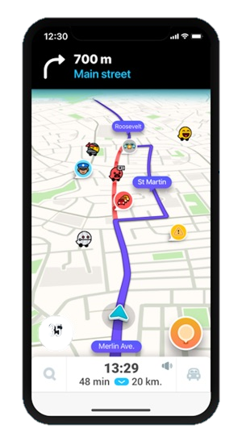
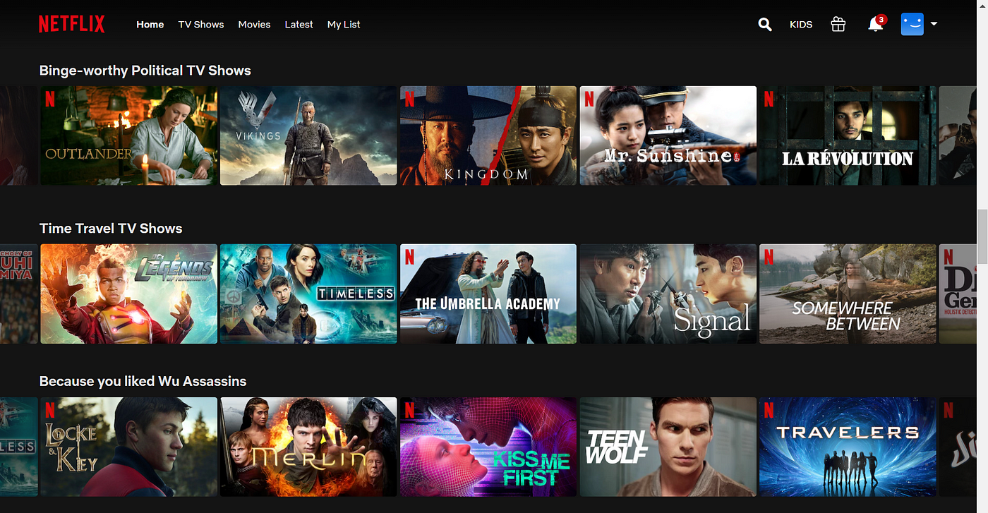

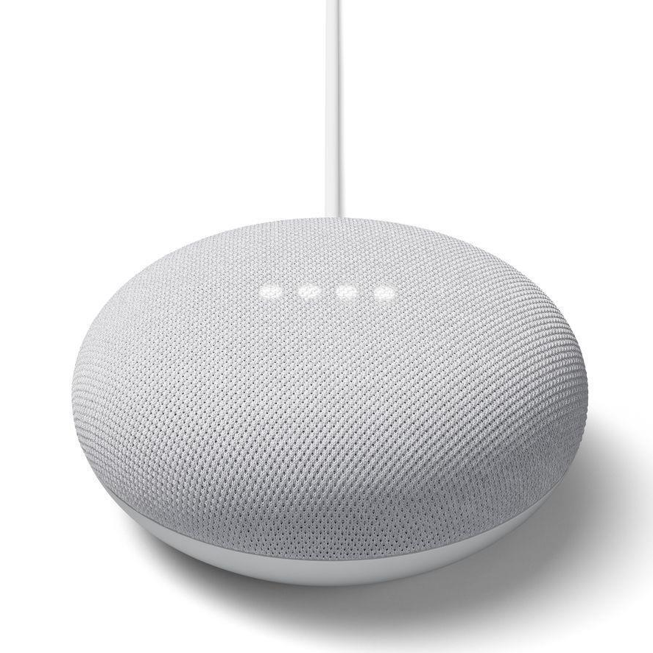
¿Dónde encuentras la IA hoy en día?
Notes:
Instructions: provide examples of where we see AI in tools they already use today.
Some examples to use:
Navigation apps learn the road, the information from other drivers…
Netflix recommendations are based on AI that learns from how people use Netflix
Siri and Alexa can understand natural language when speaking with them and respond in natural language

Slide 12
La IA puede crear contenido para nosotros
IA que puede crear texto, imágenes, canciones, videos y más.
Lo llamamos “IA Generativa”
Notes:
Instructions: Explain that Gen AI is a new category that is focused on creating content

Slide 13
Notes:
Instructions: This Coca Cola commercial was created using AI. AI is being used in so many aspect
https://www.youtube.com/watch?v=nSmNy9iLhZ4&ab_channel=FanaticalFuturistby311Institute

Slide 14
Ahora vamos a inventar un nuevo superhéroe
Mi superhéroe será una niña de 10 años
¿Qué poder debería tener?
Me gustaría que tuviera alas, ¿de qué color?
¿Ideas adicionales?
Notes:
Instructions: Explain that we’re going to invent a superhero, we will start from our ideas and then AI will help us make it real.
Provide your own example (you can update the slide), choose a female character to provide inspiration to the girls in the class.
Together with the class, give her 2-3 basic characteristics (at least some should be related to how she looks like, in order to generate her image later).
Advanced classes: Discuss more characteristics: texture of the wings? Additional features like accessories? Where does she live?

Slide 15
Ahora vamos a inventar un nuevo superhéroe
Tómate un minuto para imaginar a tu superhéroe
¿Algo especial sobre su disfraz? (¿una corona, alas, un cinturón verde?)
¿Cuál será su superpoder?
Notes:
Instructions: Now it’s the classes turn – take a few minutes to invent your own superhero.

Slide 16
¿Cómo puede ayudarnos la IA aquí?
Notes:
Instructions: Explain how AI can help us – show Copilot and explain it’s a Generative AI tool that creates text for us.
Show how you ask it to help build your character (you can ask: what color of clothes should she wear? How should I call her?)
Critical thinking: You can decide whether to take AIs advice or not, you can provide your feedback and ask for changes or more ideas.

Slide 17
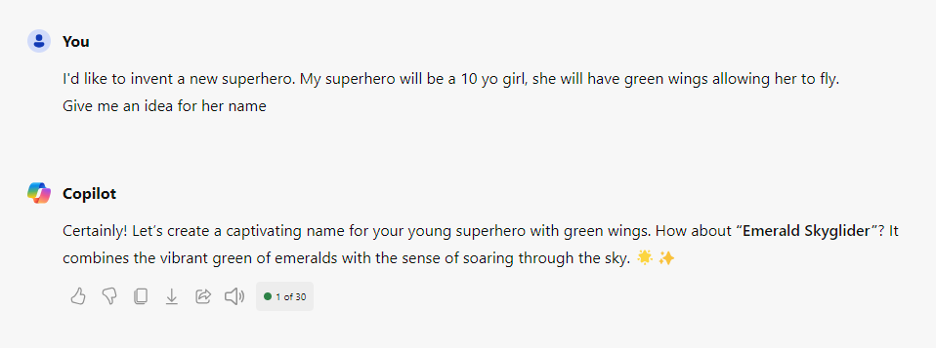
How can AI help us here?
This is a placeholder, the instructor will show a live demo of this scenario
Notes:
Instructions: Explain how AI can help us – show Copilot and explain it’s a Generative AI tool that creates text for us.
Show how you ask it to help build your character (you can ask: what color of clothes should she wear? How should I call her?)
Explain that AI is also learning from their usage. They are making an impact: When you use GenAI, you're not just a user; you're actually helping to improve and shape it for the better.
Critical thinking: You can decide whether to take AIs advice or not, you can provide your feedback and ask for changes or more ideas.

Slide 18
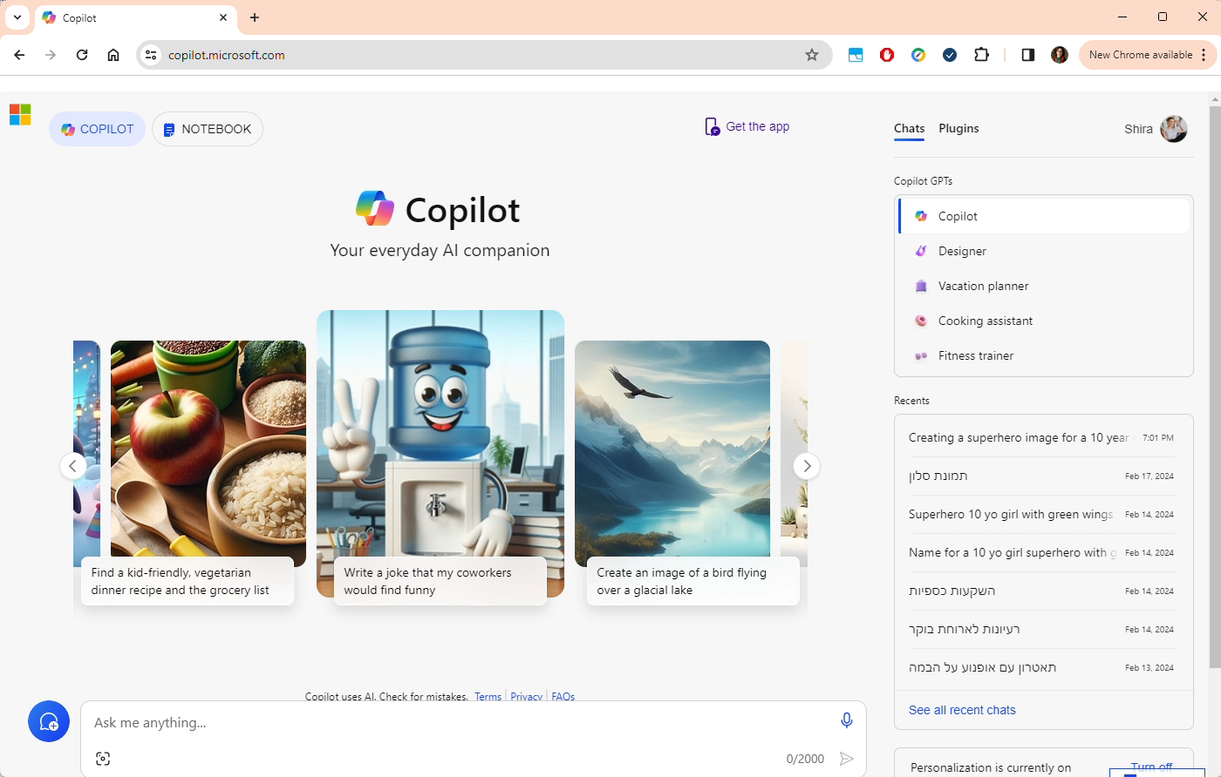
Notes:
Instructions: Explain how AI can help us – show Copilot and explain it’s a Generative AI tool that creates text for us.
Show how you ask it to help build your character (you can ask: what color of clothes should she wear? How should I call her?)
Explain that AI is also learning from their usage. They are making an impact: When you use GenAI, you're not just a user; you're actually helping to improve and shape it for the better.
Critical thinking: You can decide whether to take AIs advice or not, you can provide your feedback and ask for changes or more ideas.

Slide 19
Tu turno
Usa Copilot, inicia sesión, pregunta "ayúdame a describir a mi superhéroe..."
¿Consigue ideas para su disfraz?
¿Le das un nombre?
https://copilot.microsoft.com/
Notes:
Instructions: Show them how to login to Copilot and use it to enrich their character
For any unexpected issues you can use ChatGPT as an alternative.

Slide 20
¿Cómo sería su aspecto?
Notes:
Instructions: Explain that now we’re going the create her pictures! We’re going to ask copilot to create images for us
Note: after the class, share the images you created with the kids (on your laptop) with the Amdocs team

Slide 21
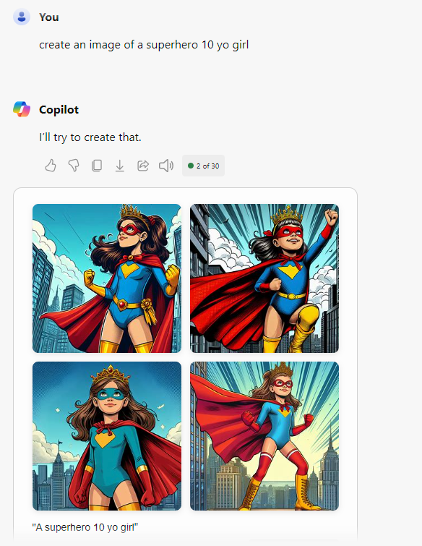
¿Cómo sería su aspecto?
This is a placeholder, the instructor will show
a live demo of
this scenario
Notes:
Instructions: Explain that now we’re going the create her pictures! We’re going to ask copilot to create images for us.
Explain that when providing general instructions we get a pretty general superhero image. (e.g. “Create an image of a superhero 10 yo girl”)

Slide 22
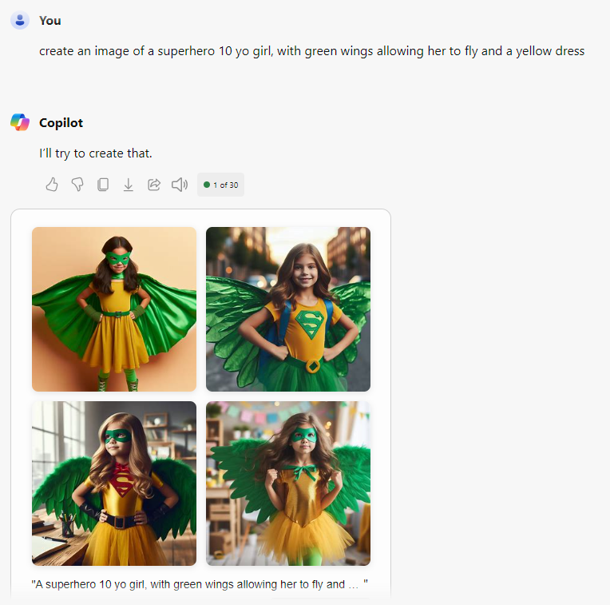
¿Cómo sería su aspecto?
This is a placeholder, the instructor will show
a live demo of
this scenario
Notes:
Instructions: Show how using more concrete directions gives us the results we want (clothes, wings, item colors, etc.)
For advanced classes, older kids etc. – try various prompts to change the style and add more content, for example:
“Create a cartoon of a 10 yo superhero girl with green wings”
“Create a Pixar style image of a 10 yo superhero girl with green wings. She is in class studying with her friends”

Slide 23
Tu turno
Usa Copilot para crear la imagen
Pregunta a Copilot: "Crea una imagen de un/una..."
Intenta describirla de maneras adicionales y ve cuáles resultados te gustan más
Notes:
Instructions: Now it’s the classes turn – take a few minutes to create the images of the suprhero

Slide 24
Conclusión

Slide 25
Conclusión
¿Qué hemos aprendido?
Notes:
Instructions: Summarize quickly the tools they’ve tried and the abilities they now have – they can generate text and images using copilot
Ask: What did you like most today? What surprised you?

Slide 26
Conclusión
¿Qué hemos aprendido?
¿Cómo puede ayudarte?
Notes:
Instructions: Discuss how they can use what they’ve learned, how they can use AI in their day to day
Ask: How do you think you can use AI in your day to day? Direct them to specific domains – how can it help at home? With your hobbies? At school? …
Critical thinking: Explain that AI is not always correct, it might invent “facts” that are not real, and we need to check them.
Examples to share with the class:
What should I make for dinner? I have eggs, milk, tomatoes
Create a birthday song for my friend
Create a birthday card for my mother
How can the tools help you in school? Learn about new domains we are learning in class (be sensitive – not all teachers might like it ☺)
It’s my 12 birthday next month, what should I ask as a gift?
Learn something new: what’s the origin of the next holiday?
How can I make a chocolate cake?

Slide 27
Conclusión
¿Qué hemos aprendido?
¿Cómo puede ayudarte?
¿Cómo puedes ayudarlo?
Notes:
Instructions: How can you help AI? AI is always learning, it’s also learning from you when you use it

Slide 28
Conclusión
¿Qué hemos aprendido?
¿Cómo puede ayudarte?
¿Cómo puedes ayudarlo?
¿Podemos confiar en la IA?
Notes:
Instructions: Ask the kids - Can I trust every answer I get from AI? Can I tell AI everything I want?
Remind them about the game we started with – it’s difficult to know what’s real and what’s not real, and as technology becomes more advance it will be even more difficult, so we need to be cautious and remember that not everything we see or read is real.
Explain that AI will always answer, even if it doesn’t really know the correct answer, and we should be careful about how we use the result we get from AI. IT’s great to get ideas from it and generate content, but if we’re looking for facts we need to be more cautious
Remind them that AI keeps learning, and it’s also learning from our usage and from what you ask

Slide 29




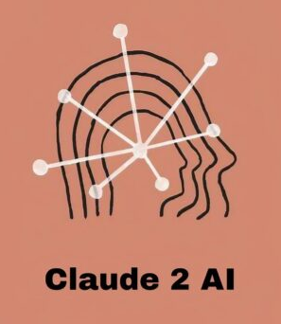


Herramientas adicionales para probar en casa
Generación de texto
Generación de imágenes
Notes:
Instructions: for advanced classes, you can direct them to additional tools they can try at home by themselves
Text generation:
https://gemini.google.com/app
https://chat.openai.com/
https://claude.ai/
Image generation:
https://ideogram.ai/
https://clipdrop.co/
https://firefly.adobe.com/

Slide 30
Gracias

