Slide 1
Prompt Your Future!
GenAI Toolkit
International Women’s Day
Shira Weinberg Harel, Product and AI Expert
This deck includes:
Instructor preparation
Lesson content

Slide 2
AI Lesson –
Instructor
Preparation
International Women Day
Amdocs project for IWD,
Shira Weinberg Harel

Slide 3
Hi Instructor,
Welcome to the toolkit, this presentation will prepare
and guide you towards a 45-60 min AI lesson for kids.
This effort is a part of the IWD campaign encouraging women
and girls to actively engage with GenAI (generative AI) products.
By using GenAI products they can influence their development,
ensure responsiveness to their unique perspectives, and ultimately, foster the creation of better outcomes.
This deck includes the preparation you should perform in advance, handling special cases, and the actual lesson presentation and flow. The target audience is kids ages 9-13.
In the lesson slides, each slide’s notes include the teaching instructions.

Slide 4
Lesson goals
1
2
3
Introduce
the students
to artificial
intelligence
Enable them to
interact with Gen-AI
tools, building their competence and confidence in using
these technologies
for creative and
practical applications.
Encourage critical thinking about the
use of AI, including considerations of fake information and harmful potential uses.

Slide 5
What are you going to cover?
1
2
3
4
You’ll begin with
presenting yourself
and explaining what is AI.
In the main exercise, the kids will invent a new superhero, this exercise includes a few steps:
  Individual thinking – who will be my superhero, how would she look like etc.
  Text generation (using Copilot) – Introduce the tool and use it to add depth to the character.
  Image generation (using Copilot)
  – Introduce the tool and use it to
  create images of the superhero.
Note: each of these steps will start by your demo. When inventing your superhero with the class, you should choose a girl superhero, to seamlessly encourage the girls to create a girl superhero, and so we can share it in the social campaign.
Wrap up by
sharing the results with the class and summarize what they’ve learnt.
Discuss how can
they use AI in
their day to day.

Slide 6
Lesson plan
TITLE | TIME | CONTENT
AI Intro | 10 min | AI game, What is AI and how can it help us?
Invent your own superhero | 5 min | Explain + short exercise
Using text generation tool to enrich the superhero character | 10 min | Demo Copilot + class exercise
Create an image of our superhero | 15 min | Demo image creation with Copilot + class exercise
Summary and Reflection – How can AI help us? | 5-10 min | Wrap up – what did we learn? Discuss how AI can assist in their day to day

Slide 7
Technical preparations
Copilot https://copilot.microsoft.com (Backup tools: Google Gemini/ChatGPT
for text, ideogram.ai for images).
In case you’re not using English for
the lesson, test Copilot with the required language. (In the unlikely case where
the language is not supported, you
can use English).
Make sure the kids have computers (or cellphones) and an internet connection for the exercises, they
can work in pairs (even trios
if needed).
Make sure you can present your computer on a big screen/projector
in class.
Using Copilot: the kids will need to
login in order to generate images,
ask the teacher in advance if they have Microsoft accounts, or plan together to create the accounts at home before the session since parent approval is required for creating a kid account (instructions on slide 8).
Make sure the
tools are available
in your market:
Language Test:
Class Preparation:

Slide 8
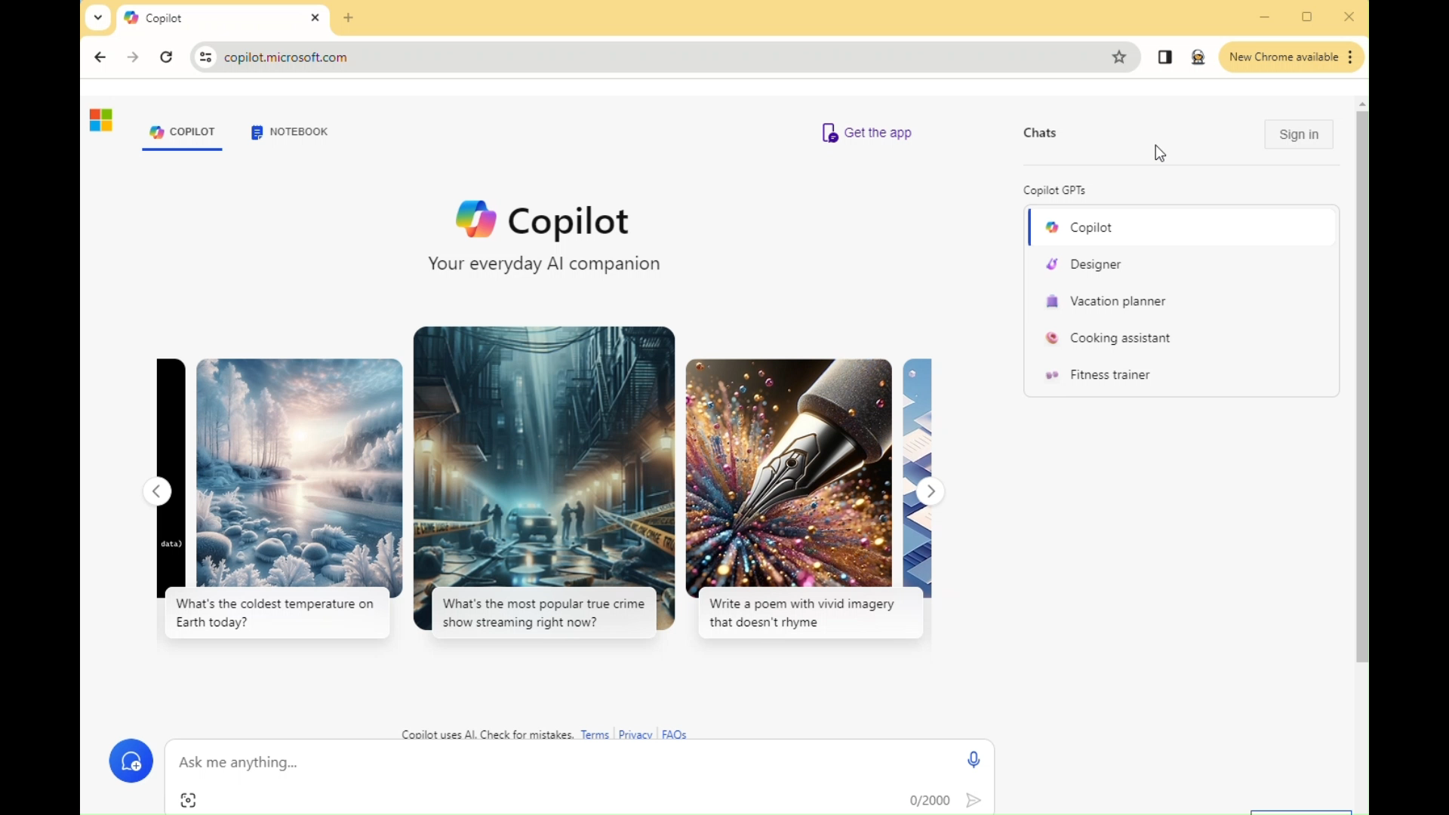
How to Create a Microsoft Account
Notes:
Go to Microsoft Copilot: https://copilot.microsoft.com/

Slide 9
After the Class
Place the images that you created with the class
(on your laptop) in the shared folder click here
Note that the file name should include:
Your full name + city + country
We encourage you to share your experience and the images you created with class on social media using these hashtags:
#PromptYourFuture #IWD2024 #Amdocs
Notes:
Place the images that you created with the class
(on your laptop) in the shared folder:
https://amdocs.sharepoint.com/sites/PromptYourFutureGenAIimages-InternationalWomen%27sDayactivity
Note that the file name should include: Employee’s Full name + city + country

Slide 10
Prepare For the Unexpected
How to handle gaps
A Kid Can’t Login
Alternative tools – in case
of any issues with copilot
Work in couples/trios
Ask teacher to assist with logging in
Create a backup account in
advance that you could give
them to use
Google Gemini can create
both text and images
You can also use Ideogram.ai
(login with a Google account)
for image generation

Slide 11
Special cases – Handling Advanced Classes
For kids older than 13 or kids that are already
familiar with the tools, you can add more complexity:
Text part:
Image part
Additional discussion about biases in AI:
A brainstorm discussion with the chat about the superhero, instead of basic concrete questions. Ask the chat:
Give me 5 ideas for her outfit
Which one is better? Prioritize
them in a table
Such examples will teach them advanced method of working with the AI chat, controlling the output format etc.
Trying various styles of images, creating a more complex prompt such as
“a 10 yo superhero… Pixar style” (more examples:
black and white, Disney
style, cartoon, photo).
if I ask for a superhero I’ll get an image of a young white man. What do you think about that?

Slide 12
Special cases – Holding an online class
While holding the class online is not ideal, we
understand that sometimes there is no F2F alternative.
Interaction with the class: keep them engaged and create transparency, ask
them questions (in most cases, the meeting chat would be the best platform for it).
Based on the current part of the class ask them:
“What do you know about AI? What is it? Write your thoughts
in the chat”
In the images game, ask them “type your answer in the chat – left or right”
While practicing ask “Once you have any results from Copilot, share them in the chat so we can all see! That will also allow me to know when to move to
the next part”
Ask them to
raise their hand
via Zoom/Teams or
write in the chat if they have questions
Prepare the teacher in advance to assist with technical issues
in the class/login issues etc. which will be more difficult to diagnose remotely

